Slide 1
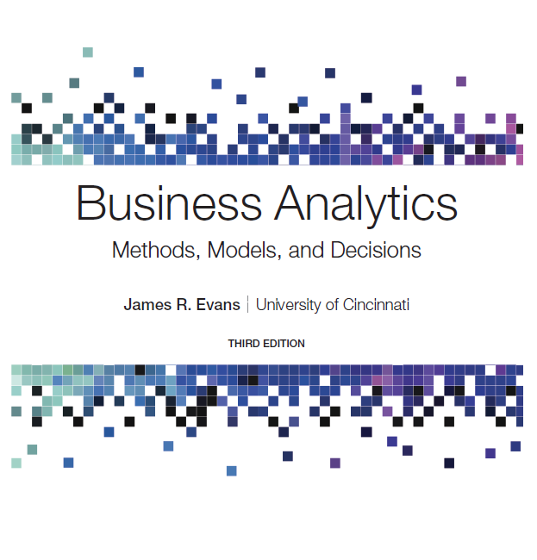
Business Analytics: Methods, Models, and Decisions
Third Edition
Chapter 16
Decision Analysis
Copyright © 2020, 2016, 2013 Pearson Education, Inc. All Rights Reserved
Notes:
If this PowerPoint presentation contains mathematical equations, you may need to check that your computer has the following installed:
1) MathType Plugin
2) Math Player (free versions available)
3) NVDA Reader (free versions available)

Slide 2
Role of Decision Analysis
The purpose of business analytics is to provide decision-makers with information needed to make decisions.
Making good decisions requires an assessment of intangible factors and risk attitudes.
Decision analysis is the study of how people make decisions, particularly when faced with imperfect or uncertain information, as well as a collection of techniques to support decision choices.

Slide 3
Formulating Decision Problems
Many decisions involve making a choice between a small set of decisions with uncertain consequences.
Decision problems involve:
decision alternatives
uncertain events that may occur after a decision is made along with their possible outcomes (which are often called states of nature), and are defined so that one and only one of them will occur.
consequences associated with each decision and outcome, which are usually expressed as payoffs. Payoffs are often summarized in a payoff table, a matrix whose rows correspond to decisions and whose columns correspond to events.
The decision maker first selects a decision alternative, after which one of the outcomes of the uncertain event occurs, resulting in the payoff.

Slide 4
Example 16.1: Selecting a Mortgage Instrument
A family is considering purchasing a new home and wants to finance $150,000. Three mortgage options are available and the payoff table for the outcomes is shown below. The payoffs represent total interest paid under three future interest rate situations.
Decision | Outcome: Rates Rise | Outcome: Rates Stable | Outcome: Rates Fall
1-year A R M | $61,134 | $46,443 | $40,161
3-year A R M | $56,901 | $51,075 | $46,721
30-year fixed | $54,658 | $54,658 | $54,658
The best decision depends on the outcome that may occur. Since you cannot predict the future outcome with certainty, the question is how to choose the best decision, considering risk.

Slide 5
Decision Strategies Without Outcome Probabilities: Minimize Objective
With a minimize objective, the payoffs are costs.
Aggressive (Optimistic) Strategy
Choose the decision that minimizes the smallest payoff that can occur among all outcomes for each decision (minimin strategy).
Conservative (Pessimistic) Strategy
Choose the decision that minimizes the largest payoff that can occur among all outcomes for each decision (minimax strategy).
Opportunity Loss Strategy
Choose the decision that minimizes the largest opportunity loss among all outcomes for each decision (minimax regret)

Slide 6
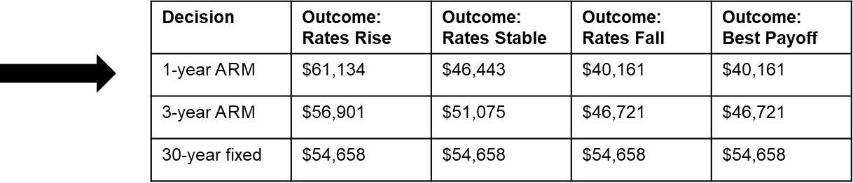
Example 16.2: Mortgage Decision with the Aggressive Strategy
Determine the lowest payoff (interest cost) for each type of mortgage, and then choose the decision with the smallest value (minimin).

Slide 7
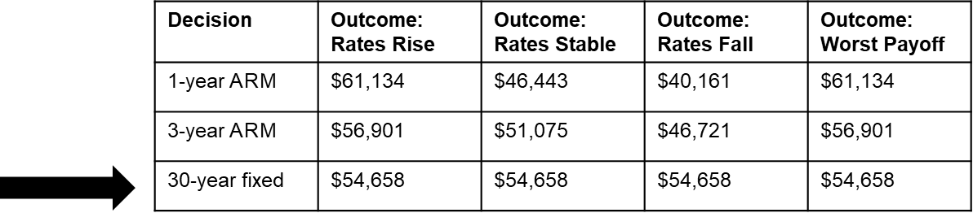
Example 16.3: Mortgage Decision with the Conservative Strategy
Determine the largest payoff (interest cost) for each type of mortgage, and then choose the decision with the smallest value (minimax).

Slide 8
Understanding Opportunity Loss
Opportunity loss represents the “regret” that people often feel after making a nonoptimal decision.
In general, the opportunity loss associated with any decision and event is the difference between the best decision for that particular outcome and the payoff for the decision that was chosen.
Opportunity losses can be only nonnegative values.

Slide 9
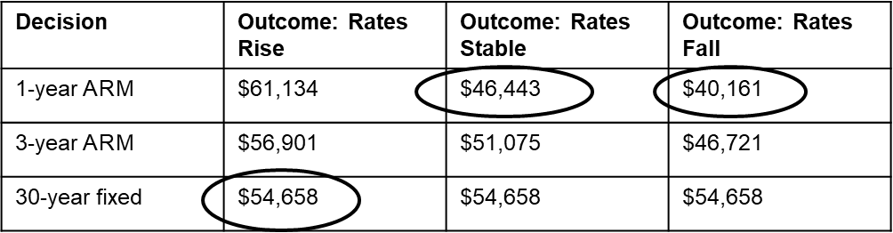
Example 16.4: Mortgage Decision with the Opportunity-Loss Strategy (1 of 2)
Compute the opportunity loss matrix.
Step 1:Find the best outcome (minimum cost) in each column.
Step 2:Subtract the best column value from each value in the column.
Decision | Outcome: Rates Rise | Outcome: Rates Stable | Outcome: Rates Fall
1-year A R M | $6,476 | $− | $−
3-year A R M | $2,243 | $4,632 | $6,560
30-year fixed | $− | $8,215 | $14,497

Slide 10
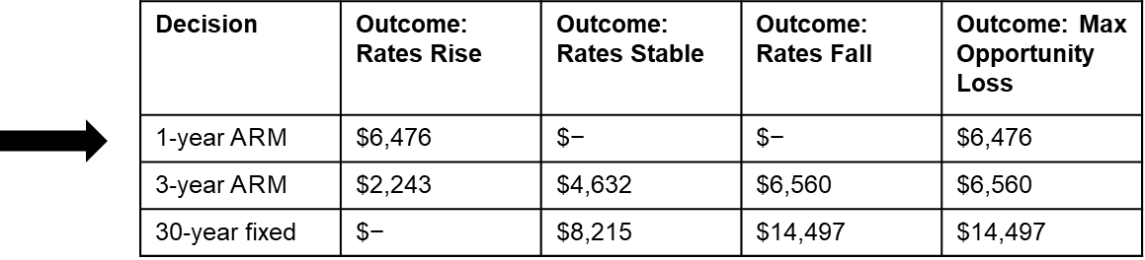
Example 16.4: Mortgage Decision with the Opportunity-Loss Strategy (2 of 2)
Find the “minimax regret” decision
Step 3: Determine the maximum opportunity loss for each decision, and then choose the decision with the smallest of these.
Using this strategy, we would choose the 1-year A R M. This ensures that, no matter what outcome occurs, we will never be more than $6,476 away from the least cost we could have incurred.

Slide 11
Decision Strategies Without Outcome Probabilities: Maximize Objective
With a maximize objective, the payoffs are profits.
Aggressive (Optimistic) Strategy
Choose the decision that maximizes the largest payoff that can occur among all outcomes for each decision (maximax strategy).
Conservative (Pessimistic) Strategy
Choose the decision that maximizes the smallest payoff that can occur among all outcomes for each decision (maximin strategy).
Opportunity Loss Strategy
Choose the decision that minimizes the maximum opportunity loss among all outcomes for each decision (minimax regret).
Note that this is the same as for a minimize objective; however, calculation of the opportunity losses is different.

Slide 12
Decisions with Conflicting Objectives
Many decisions require some type of tradeoff among conflicting objectives, such as risk versus reward.
A simple decision rule can be used whenever one wishes to make an optimal tradeoff between any two conflicting objectives, one of which is good, and one of which is bad, that maximizes the ratio of the good objective to the bad.
First, display the tradeoffs on a chart with the “good” objective on the x-axis, and the “bad” objective on the y-axis, making sure to scale the axes properly to display the origin (0,0).
Then graph the tangent line to the tradeoff curve that goes through the origin.
The point at which the tangent line touches the curve (which represents the smallest slope) represents the best return to risk tradeoff.

Slide 13
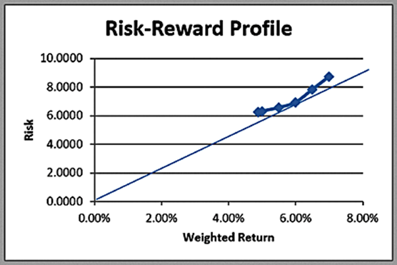
Example 16.5: Risk-Reward Tradeoff Decision for Innis Investments Example
From Figure 15.2, if we take the ratios of the weighted returns to the minimum risk values in the table, we will find that the largest ratio occurs for the target return of 6%.
We can explain this easily from the chart by noting that for any other return, the risk is relatively larger (if all points fell on the tangent line, the risk would increase proportionately with the return).

Slide 14
Summary of Decision Strategies Under Uncertainty (1 of 2)
Objective | Strategy | Aggressive Strategy | Conservative Strategy | Opportunity-Loss Strategy
Minimize objective | Choose the decision with the smallest average payoff. | Find the smallest payoff for each deci- Sion among all Out- comes and choose the decision with the smallest of these (minim in). | Find the largest pay- off for each decision among all Outcomes and choose the deci-Sion with the smallest of these (minimax). | For each outcome, cornpute the opportunity loss for each decision as the absolute difference between its payoff and the smallest payoff for that outcome. Find the maximum opportunity loss for each decision and choose the decision with the smallest opportunity loss (minimax regret).

Slide 15
Summary of Decision Strategies Under Uncertainty (2 of 2)
Objective | Strategy | Aggressive Strategy | Conservative Strategy | Opportunity-Loss Strategy
Maximize objective | Choose the decision with the largest average payoff. | Find the largest pay-off for each decision among all outcomes and choose the decision with the largest of these (maximax). | Find the smallest pay- off for each decision among all outcomes and choose the decision with the largest of these (maximin). | For each outcome, compute the opportunity loss for each decision as the absolute difference between its payoff and the largest payoff for that outcome. Find the maximum opportunity loss for each decision and choose the decision with the smallest opportunity loss (minimax regret).

Slide 16
Decision Strategies with Outcome Probabilities
In many situations, we might have some assessment of these probabilities, either through some method of forecasting or reliance on expert opinions.
If we can assess a probability for each outcome, we can choose the best decision based on the expected value.
The simplest case is to assume that each outcome is equally likely
to occur; that is, the probability of each outcome is
where N is the number of possible outcomes. This is called the average payoff strategy.

Slide 17
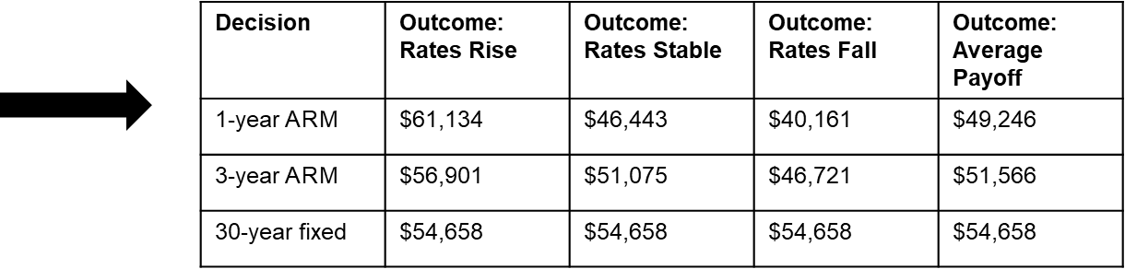
Example 16.6: Mortgage Decision with the Average Payoff Strategy
Estimates for the probabilities of each outcome are shown in the table below.
For each loan type, compute the expected value of the interest cost and choose the minimum.

Slide 18
Expected Value Strategy
A more general case is when the probabilities of the outcomes are not all the same. This is called the expected value strategy.
We may use the expected value calculation that we introduced in formula (5.12) in Chapter 5.

Slide 19
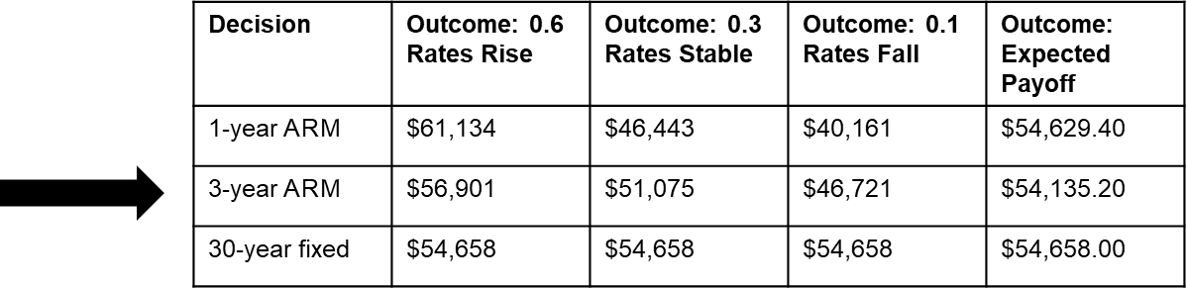
Example 16.7: Mortgage Decision with the Expected Value Strategy
Estimates for the probabilities of each outcome are shown in the table below.
For each loan type, compute the expected value of the interest cost and choose the minimum.

Slide 20
Evaluating Risk
An implicit assumption in using the average payoff or expected value strategy is that the decision is repeated a large number of times. However, for any one-time decision (with the trivial exception of equal payoffs), the expected value outcome will never occur-only one of the actual outcomes will occur for the decision chosen.
For a one-time decision, we must carefully weigh the risk associated with the decision in lieu of blindly choosing the expected value decision.

Slide 21
Example 16.8: Evaluating Risk in the Mortgage Decision
Standard deviation of each decision:
Decision | Standard Deviation
1-year A R M | $10,763,80
3-year A R M | $5,107.71
30-year fixed | $−
Based solely on the standard deviation, the 30-year fixed mortgage has no risk at all, whereas the 1-year A R M appears to be the riskiest.
While none of the previous decision strategies chose the 3-year A R M, it may be attractive to the family due to its moderate risk level and potential upside at stable and falling interest rates.

Slide 22
Decision Trees
A decision tree is a graphical model used to structure a decision problem involving uncertainty.
Nodes are points in time at which events take place.
Decision nodes are nodes in which a decision takes place by choosing among several alternatives (typically denoted as squares).
Event nodes are nodes in which an event occurs not controlled by the decision-maker (typically denoted as circles).
Branches are associated with decisions and events.
Decision trees model sequences of decisions and outcomes over time.

Slide 23
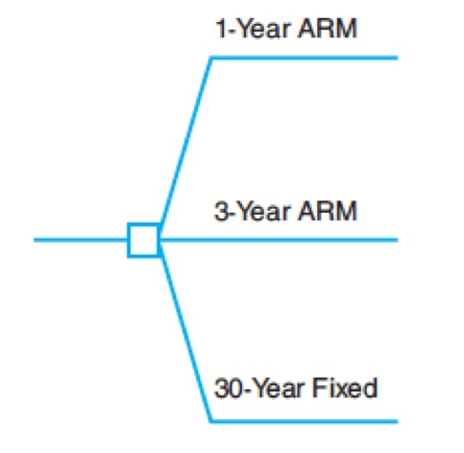
Example 16.9: Creating a Decision Tree (1 of 3)
Mortgage selection problem
To start the decision tree, add a node for selection of the loan type.

Slide 24
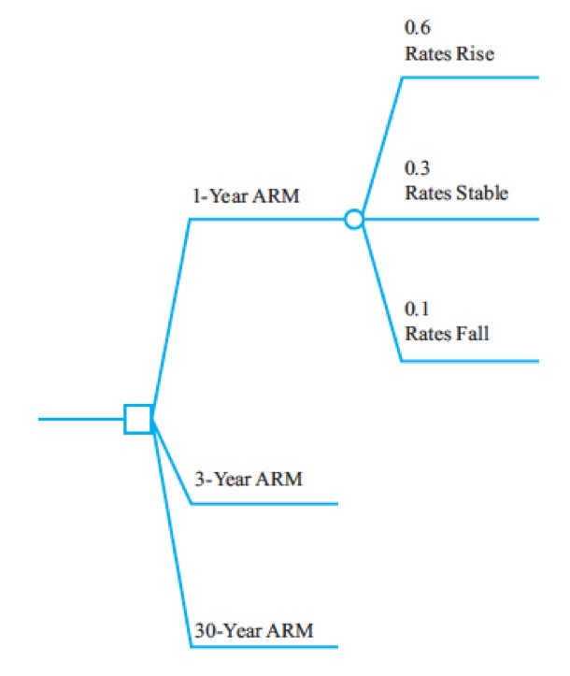
Example 16.9: Creating a Decision Tree (2 of 3)
Next, for each type of loan, add a node for selection of the uncertain interest rate conditions.

Slide 25
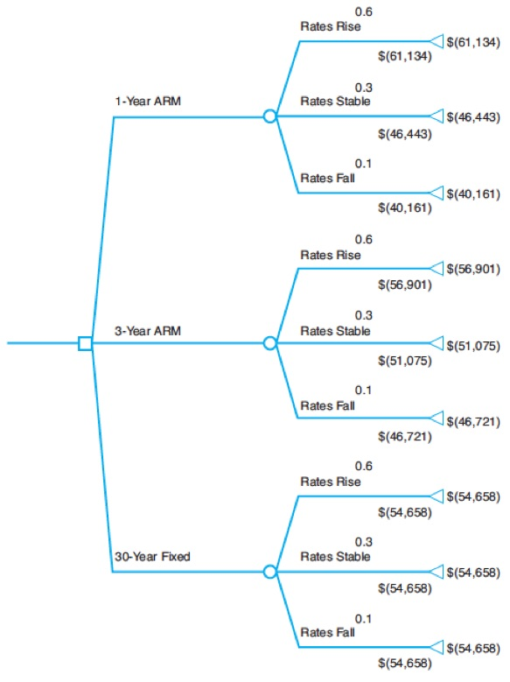
Example 16.9: Creating a Decision Tree (3 of 3)
Finally, enter the payoffs of the outcomes associated with each event in the cells immediately below the branches.
Sum all payoffs along the paths and place these values next to the terminal nodes.

Slide 26
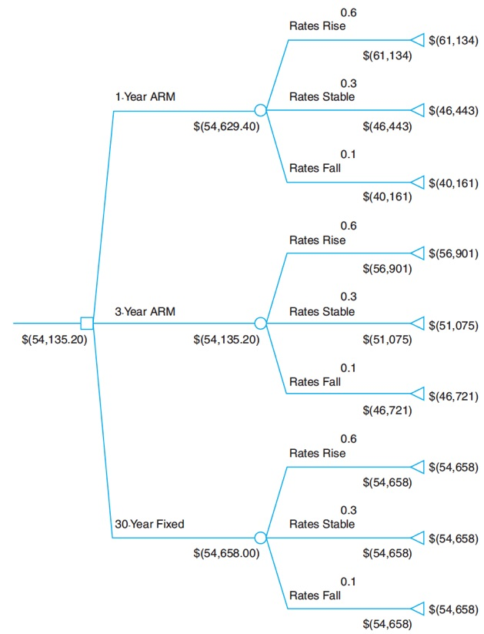
Example 16.10: Analyzing a Decision Tree (1 of 2)
To find the best decision strategy in a decision tree, “roll back” the tree by computing expected values at event nodes and selecting the optimal value of alternative decisions at decision nodes.
If the one-year A R M is chosen, the expected value of the chance events is

Slide 27
Example 16.10: Analyzing a Decision Tree (2 of 2)
At the decision node, the maximum expected value is chosen from among all decisions; this is -$54,135.20.
This corresponds to the three-year ARM, which is branch 2.

Slide 28
Example 16.11: A Pharmaceutical R&D Model (1 of 2)
Moore Pharmaceuticals (Chapter 11) needs to decide whether to conduct clinical trials and seek F D A approval for a newly developed drug.
$300 million has already been spent on research.
The next decision is whether to conduct clinical trials at a cost of $250 million.
Probability of success following trials is 0.3.
If the trials are successful, the next decision is whether to seek F D A approval, costing $25 million.
Likelihood of F D A approval is 60%.
If released to the market, revenue potential and probabilities are:
blank | Market Potential Expected Revenues (millions of $) | Probability
Large | 4,500 | 0.6
Medium | 2,200 | 0.3
Small | 1,500 | 0.1

Slide 29
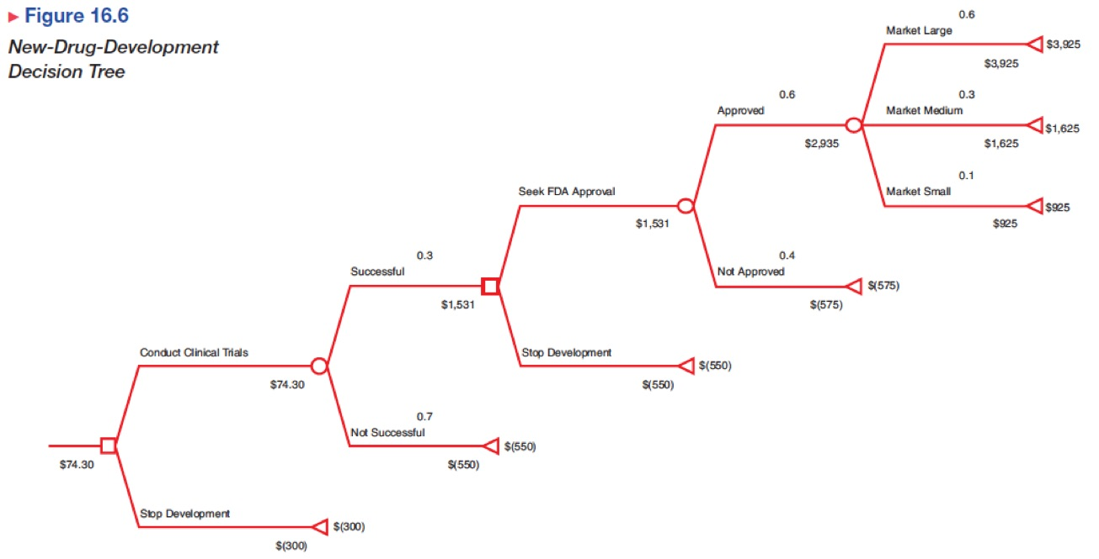
Example 16.11: A Pharmaceutical R&D Model (2 of 2)

Slide 30
Decision Trees and Risk
Decision trees are an example of expected value decision making and do not explicitly consider risk.
For Moore Pharmaceutical’s decision tree, we can form a classical decision table.
blank | Unsuccessful Clinical Trials | Successful Clinical Trials; No F D A Approval | Successful Trials and Approval; Large Market | Successful Trials and Approval; Medium Market | Successful Trials and Approval; Small Market
Develop drug | ($550) | ($575) | $3,925 | $1,625 | $925
Stop development | ($300) | ($300) | ($300) | ($300) | ($300)
We can then apply aggressive, conservative, and opportunity loss decision strategies.

Slide 31
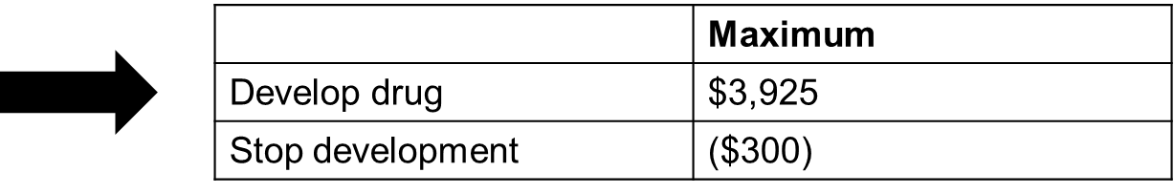
Aggressive Strategy (Maximax)
blank | Unsuccessful Clinical Trials | Successful Clinical Trials; No F D A Approval | Successful Trials and Approval; Large Market | Successful Trials and Approval; Medium Market | Successful Trials and Approval; Small Market
Develop drug | ($550) | ($575) | $3,925 | $1,625 | $925
Stop development | ($300) | ($300) | ($300) | ($300) | ($300)
Developing the new drug maximizes the maximum payoff.

Slide 32

Conservative Strategy (Maximin)
blank | Unsuccessful Clinical Trials | Successful Clinical Trials; No F D A Approval | Successful Trials and Approval; Large Market | Successful Trials and Approval; Medium Market | Successful Trials and Approval; Small Market
Develop drug | ($550) | ($575) | $3,925 | $1,625 | $925
Stop development | ($300) | ($300) | ($300) | ($300) | ($300)
Stopping development of the new drug maximizes the minimum payoff.

Slide 33
Opportunity Loss Strategy
blank | Unsuccessful Clinical Trials | Successful Clinical Trials; No F D A Approval | Successful Trials and Approval; Large Market | Successful Trials and Approval; Medium Market | Successful Trials and Approval; Small Market
Develop drug | ($550) | ($575) | $3,925 | $1,625 | $925
Stop development | ($300) | ($300) | ($300) | ($300) | ($300)
Opportunity Losses
blank | Unsuccessful Clinical Trials | Successful Clinical Trials; No F D A Approval | Successful Trials and Approval; Large Market | Successful Trials and Approval; Medium Market | Successful Trials and Approval; Small Market | Maximum
Develop drug | $250 | $275 | $− | $− | $− | $275
Stop development | $− | $− | $4,225 | $1,925 | $1,225 | $4,225
Developing the new drug minimizes the maximum opportunity loss.

Slide 34
Example 16.12: Constructing a Risk Profile (1 of 2)
Each decision strategy has an associated payoff distribution, called a risk profile.
Risk profiles show the possible payoff values that can occur and their probabilities.
Outcomes and probabilities:
Terminal Outcome | Net Revenue | Probability
Market large | $3,925 | 0.108
Market medium | $1,625 | 0.054
Market small | $925 | 0.018
F D A not approved | ($575) | 0.120
Clinical trials not successful | ($550) | 0.700
The probabilities are computed by multiplying the probabilities on the event branches along the path to the terminal outcome.

Slide 35
Example 16.12: Constructing a Risk Profile (2 of 2)
For example, the probability of getting to “Market large” is 0.3 * 0.6 * 0.6 = 0.108.

Slide 36
Sensitivity Analysis in Decision Trees
We may use Excel data tables to investigate the sensitivity of the optimal decision to changes in probabilities or payoff values.
Example 5.26 Airline Revenue Management
Full and discount airfares are available for a flight.
Full-fare ticket costs $560
Discount ticket costs $400
X = selling price of a ticket
p = 0.75 (the probability of selling a full-fare ticket)

Slide 37
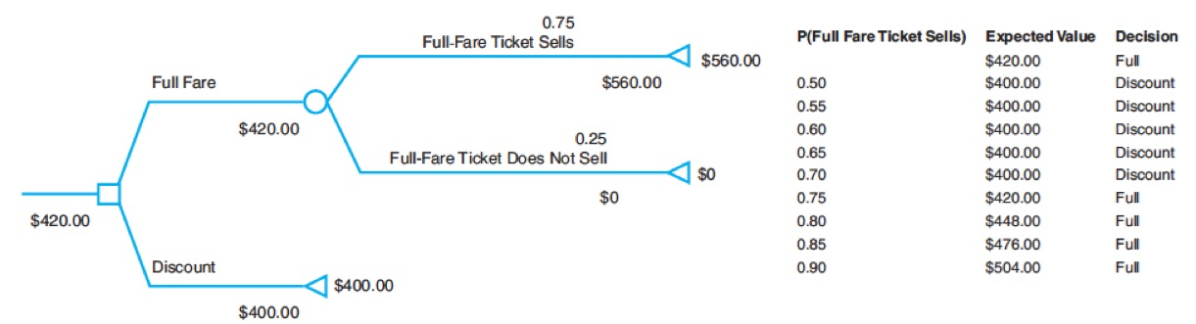
Example 16.13: Sensitivity Analysis for Airline Revenue Management Decision
What-if analysis of the impact of changing the probability that a full-fare ticket sells before the flight.
From the data table results, we see that if the probability of selling the full-fare ticket is 0.7 or less, then the best decision is to discount the price.

Slide 38
The Value of Information
The value of information is the improvement in the expected return if the decision maker can acquire additional information about the future event that will take place.
Perfect information tell us, with certainty, which outcome will occur.
Expected value of perfect information (E V P I) is expected value with perfect information minus the expected value without it.
Expected opportunity loss is the average additional amount the decision maker would have achieved if the correct decision had been made.
Minimizing expected opportunity loss always results in the same decision as maximizing expected value.

Slide 39
Example 16.14: Finding E V P I for the Mortgage-Selection Decision (1 of 2)
Find the minimum expected opportunity loss
Decision | Outcome: Rates Rise | Outcome: Rates Stable | Outcome: Rates Fall
1-year A R M | $61,134 | $46,443 | $40,161
3-year A R M | $56,901 | $51,075 | $46,721
30-year fixed | $54,658 | $54,658 | $54,658
Opportunity Losses
Decision | Outcome: 0.6 Rates Rise | Outcome: 0.3 Rates Stable | Outcome: 0.1 Rates Fall | Outcome: Expected Opportunity Loss
1-year A R M | $6,476 | $− | $− | $3,885.60
3-year A R M | $2,243 | $4,632 | $6,560 | $3,391.40=E V P I
30-year fixed | $− | $8,215 | $14,497 | $3,914.20

Slide 40
Example 16.14: Finding E V P I for the Mortgage-Selection Decision (2 of 2)
Alternate interpretation
For each outcome (perfect information), find the best decision; then compute the expected value
Decision | Outcome: 0.6 Rates Rise | Outcome:0.3 Rates Stable | Outcome: 0.1 Rates Fall | Outcome: Expected Payoff
1-year A R M | $61,134 | $46,443 | $40,161 | $54,629.40
3-year A R M | $56,901 | $51,075 | $46,721 | $54,135.20
30-year fixed | $54,658 | $54,658 | $54,658 | $54,658.00
Compute expected payoff of the best decisions:
Without perfect information, the best decision is the 3-year A R M with an expected cost of $54,135.20. E V P I is the difference (amount saved by having perfect information): $54,135.20 − $50,743.80 = $3,391.40.

Slide 41
Decisions with Sample Information
Sample information is the result of conducting some type of experiment, such as a market research study or interviewing an expert.
The expected value of sample information (E V S I) is the expected value with sample information (assumed at no cost) minus the expected value without sample information; it represents the most you should be willing to pay for the sample information.

Slide 42
Example 16.15: Decisions with Sample Information (1 of 3)
A company is developing a new cell phone and currently has two models under consideration.
Historically, 70% of their new phones have had high consumer demand and 30% have had low consumer demand.
Model 1 requires $200,000 investment.
If demand is high, revenue = $500,000
If demand is low, revenue = $160,000
Model 2 requires $175,000 investment.
If demand is high, revenue = $450,000
If demand is low, revenue = $160,000

Slide 43
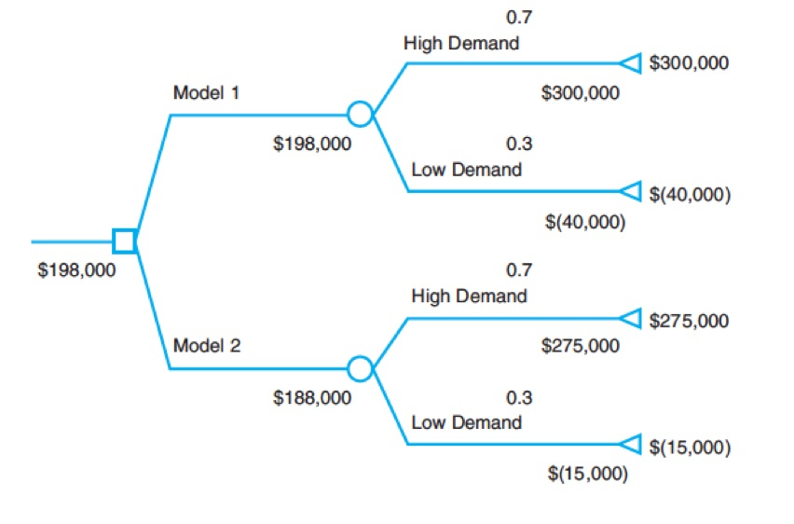
Example 16.15: Decisions with Sample Information (2 of 3)
Decision tree (values in thousands)
Best decision is to select model 1.

Slide 44
Example 16.15: Decisions with Sample Information (3 of 3)
A market research study is conducted to obtain sample information about consumer demand.
Similar studies have found:
90% of all products that had high consumer demand had previously received high market survey responses.
20% of all products that had low consumer demand had previously received high market survey responses.
We should expect that a high survey response would increase the historical probability of high demand, whereas a low survey response would increase the historical probability of a low demand.
We need to compute conditional probabilities:

Slide 45
Bayes’s Rule
Bayes’s rule allows revising historical probabilities based on sample information.

Slide 46
Example 16.16: Applying Bayes’s Rule to Compute Conditional Probabilities (1 of 3)
Define
Using Bayes’s rule

Slide 47
Example 16.16: Applying Bayes’s Rule to Compute Conditional Probabilities (2 of 3)
Using Bayes’s rule

Slide 48
Example 16.16: Applying Bayes’s Rule to Compute Conditional Probabilities (3 of 3)
Compute marginal probabilities

Slide 49
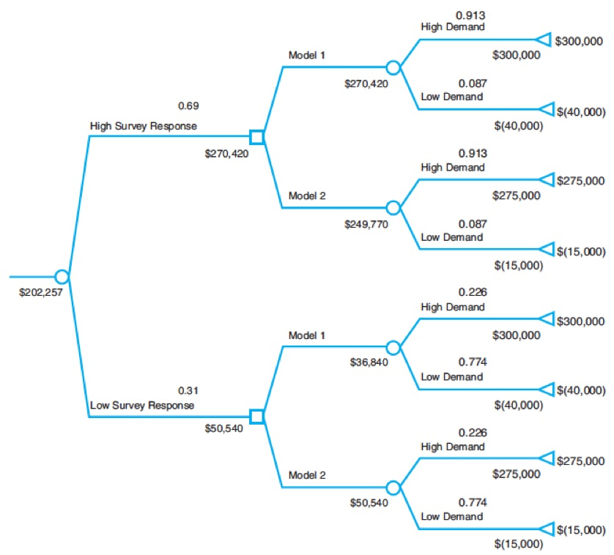
Decision Tree with Market Survey Information
Select model 1 if the survey response is high; and if the response is low, then select model 2.
E V S I = $202,257 − $198,000 = $4,257.

Slide 50
Utility and Decision Making
Utility theory is an approach for assessing risk attitudes quantitatively.
This approach quantifies a decision maker’s relative preferences for particular outcomes.
We can determine an individual’s utility function by posing a series of decision scenarios.

Slide 51
Example 16.17: A Personal Investment Decision
Suppose you have $10,000 to invest short-term.
You are considering 3 options:
Bank C D paying 4% return
Bond fund with uncertain return
Stock fund with uncertain return
Bond and stock funds are sensitive to interest rates
Decision/Event | Rates Rise | Rates Stable | Rates Fall
Bank C D | $400 | $400 | $400
Bond fund | −$500 | $840 | $1,000
Stock fund | −$900 | $600 | $1,700

Slide 52
Constructing a Utility Function
Sort the payoffs from highest to lowest.
Assign a utility to the highest payoff of
Assign a utility to the lowest payoff of
For each payoff between the highest and lowest, consider the following situation:
Suppose you have the opportunity of achieving a guaranteed return of x or taking a chance of receiving the highest payoff with probability p or the lowest payoff with probability 1 − p.
The term certainty equivalent represents the amount that a decision maker feels is equivalent to an uncertain gamble.
What value of p would make you indifferent to these two choices?
Then repeat this process for each payoff.

Slide 53
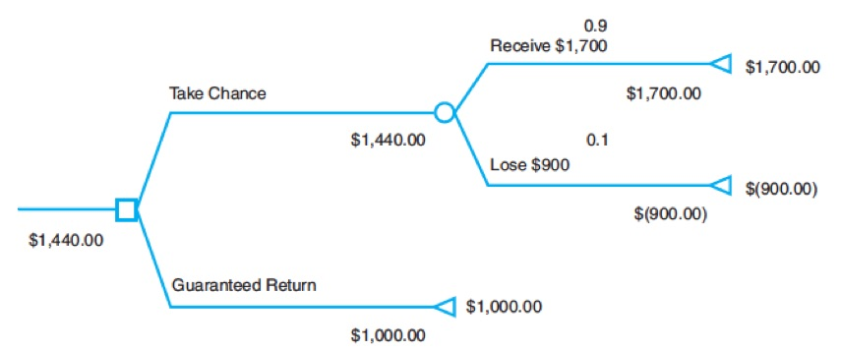
Example 16.18: Constructing a Utility Function for the Personal Investment Decision (1 of 2)
Payoff, X | Utility ,U(X)
$1,700 | 1.0
$1000 | blank
$840 | Blank
$600 | blank
$400 | blank
−$500 | blank
−$900 | 0.0
the probability you would give up a certain $1000 to possibly win a $1700 payoff. Suppose this is 0.9.
Decision tree characterization:

Slide 54
Example 16.18: Constructing a Utility Function for the Personal Investment Decision (2 of 2)
Final utility function
Payoff, X | Utility ,U(X)
$1,700 | 1.0
$1000 | 0.90
$840 | 0.85
$600 | 0.80
$400 | 0.75
$(500) | 0.35
$(900) | 0.0

Slide 55
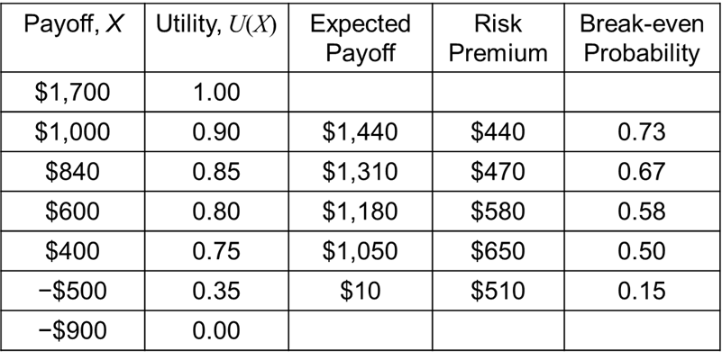
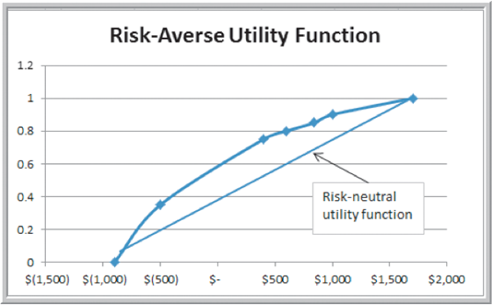
Risk Premium
The risk premium is the amount an individual is willing to forgo to avoid risk.
For the payoff of $1000, the expected value of taking the gamble is
You require a risk premium
of $1,440 − $1,000 = $440 to feel comfortable enough to risk losing $900 if you take the gamble. Such an individual is risk-averse.

Slide 56
Example Utility Function for Risk-Takers
For the payoff of $1,000, this individual would be indifferent between receiving $1,000 and taking a chance at $1,700 with probability 0.6 and losing $900 with probability 0.4.
The expected value of this gamble is
Payoff, X | Utility ,U(X)
$1,700 | 1.0
$1000 | 0.6
$840 | 0.55
$600 | 0.45
$400 | 0.40
−$500 | 0.1
−$900 | 0.0
Because this is considerably less than $1,000, the individual is taking a larger risk to try to receive $1,700.

Slide 57
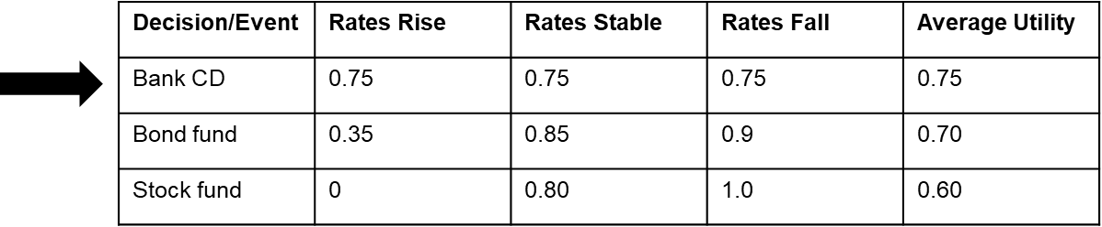
Using Utility Functions in Decision Analysis
Replace payoffs with utilities.
Example using average payoff strategy:
If probabilities are known, find the expected utility.

Slide 58
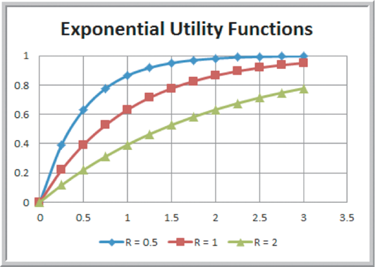
Exponential Utility Functions
An exponential utility function approximates those of risk-averse individuals:
R is a shape parameter indicative of risk tolerance.
Smaller values of R result in a more concave shape and are more risk averse.

Slide 59
Estimating the Value of R
Find the maximum payoff $R for which the decision maker believes that taking a chance to win $R is
equivalent to losing
Would you take on a bet of possibly winning $10 versus losing $5?
How about risking $5,000 to win $10,000?

Slide 60
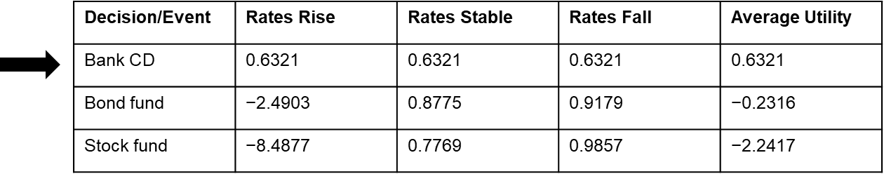
Example 16.19: Using an Exponential Utility Function
For the personal investment example, suppose that R = $400.
Payoff, X | Utility ,U(X)
$1,700 | 0.9857
$1000 | 0.9179
$840 | 0.8775
$600 | 0.7769
$400 | 0.6321
−$500 | −2.4903
−$900 | −8.4877
Use these utilities in the payoff table

